Slide 1
Chapter 2 Application Layer
application
transport
network
data link
physical
Slides are adapted from the textbook:
Computer Networking: A Top Down Approach J.F Kurose and K.W. Ross,

Slide 2
Some network apps
A network application is any application running on one host providing communication to another application running on a different host.
e-mail
web
text messaging
remote login
P2P file sharing
multi-user network games
streaming stored video (YouTube, Hulu, Netflix)
voice over IP (e.g., Skype)
real-time video conferencing (Zoom, Teams)
social networking
search
…

Slide 3

















Creating a network app
application
transport
network
data link
physical
write programs that:
run on (different) end systems
communicate over network
e.g., web server software communicates with browser software
no need to write software for network-core devices
network-core devices (switches and routers) do not run user applications
application
transport
network
data link
physical
application
transport
network
data link
physical

Slide 4
Application architectures
possible structure of applications:
client-server
peer-to-peer (P2P)

Slide 5
Client-server architecture
server:
always-on host
permanent IP address
data center with several hosts is used to create a powerful virtual server (for scaling)
clients:
communicate with server
may be intermittently connected
may have dynamic IP addresses
do not communicate directly with each other
client/server

Slide 6
P2P architecture
no always-on server
arbitrary end systems directly communicate
peers request service from other peers, provide service in return to other peers
peers are intermittently connected and change IP addresses
ex: file sharing, video conference
peer-peer

Slide 7





P2P file distribution: BitTorrent
BitTorrent is a P2P protocol for file distribution
file divided into 256Kb chunks
peers in torrent send/receive file chunks
tracker: tracks peers
participating in torrent
torrent: group of peers exchanging chunks of a file
Alice arrives …
… obtains list
of peers from tracker
… and begins exchanging
file chunks with peers in torrent

Slide 8
Processes communicating
process: program running within a host
processes in different hosts communicate by exchanging messages
clients, servers
client process: process that initiates communication
server process: process that waits to be contacted
Applications with P2P architectures have client processes & server processes
In a P2P file-sharing application, the peer that is receiving a file is typically the client and the peer that is sending the file is typically the server.

Slide 9

Sockets
process sends messages to its socket
process receives messages from its socket
socket analogous to door
sending process shoves message out the socket
sending process relies on transport infrastructure on other side of door to deliver message to socket at receiving process
application
socket
application
controlled by
app developer
process
process
transport
transport
network
network
controlled
by OS
link
Internet
link
physical
physical
A socket is the interface between the application layer and the transport layer within a host. It is also referred to as the Application Programming Interface (API)

Slide 10
Addressing processes
to receive messages, a process must have an identifier
host device has unique 32-bit IP address
Q: does the IP address of a host on which process runs suffice for identifying the process?

Slide 11
Addressing processes
to receive messages, a process must have an identifier
host device has unique 32-bit IP address
Q: does the IP address of a host on which process runs suffice for identifying the process?
The identifier of a process includes both IP address of host and a port number associated with process on host.
example port numbers:
HTTP server: 80
mail server: 25
to send HTTP message to gaia.cs.umass.edu web server:
IP address: 128.119.245.12
port number: 80
A: no, many processes can be running on same host

Slide 12
Application layer protocol defines
types of messages exchanged,
e.g., request, response
message syntax:
what fields in messages & the exact position of these fields
message semantics
meaning of information in fields
rules for when and how processes send & respond to messages

Slide 13
What transport service does an app need?
There are several transport-layer protocols that differ in the types of services they offer to the applications.
throughput
some apps (e.g., multimedia) require a minimum amount of throughput (r bps > min) to be “effective”
other apps (“elastic apps”) make use of whatever throughput they get (e.g. email)
data integrity
some apps (e.g., file transfer, web transactions) require 100% reliable data transfer
other apps (e.g., audio) can tolerate some loss
timing
some apps (e.g., Internet telephony, interactive games) require low delay to be “effective”
security
encryption, data integrity, …

Slide 14
Transport service requirements: common apps
application
file transfer
e-mail
Web documents
real-time audio/video
stored audio/video
interactive games
text messaging
data loss
no loss
no loss
no loss
loss-tolerant
loss-tolerant
loss-tolerant
no loss
throughput
elastic
elastic
elastic
audio: 5kbps-1Mbps
video:10kbps-5Mbps
same as above
few kbps up
elastic
time sensitive
no
no
no
yes, 100’s msec
yes, few secs
yes, 100’s msec
yes and no

Slide 15
Internet transport protocols services
TCP service: Transmission Control Protocol
reliable transport between sending and receiving process
flow control: sender won’t overwhelm receiver
congestion control: throttle sender when network overloaded
does not provide: timing, minimum throughput guarantee, security
connection-oriented: setup required between client and server processes
UDP service: User Datagram Protocol
unreliable data transfer between sending and receiving process
does not provide: reliability, flow control, congestion control, timing, throughput guarantee, security, or connection setup,
Q: why bother? Why is there a UDP?

Slide 16
Internet apps: application, transport protocols
application
layer protocol
SMTP [RFC 2821]
Telnet [RFC 854]
HTTP [RFC 2616]
FTP [RFC 959]
HTTP (e.g., YouTube), RTP [RFC 1889]
SIP, RTP
underlying
transport protocol
TCP
TCP
TCP
TCP
TCP or UDP
TCP or UDP
application
e-mail
remote terminal access
Web
file transfer
streaming multimedia
Internet telephony

Slide 17
Securing TCP
SSL is at app layer
apps use SSL libraries, that “talk” to TCP
The SSL socket takes unencrypted data from the application layer, encrypts it and then passes it to the TCP socket.
If application developers want TCP to be enhanced with SSL, they have to include the SSL code in the application.
TCP & UDP
no encryption
cleartext passwds sent into socket traverse Internet in cleartext
SSL (Secure Socket Layer)
provides encrypted TCP connection
data integrity
end-point authentication

Slide 18
Web and HTTP (hypertext transfer protocol)
application-layer protocol
network application

Slide 19
Web and HTTP
web page consists of objects
object can be HTML file, JPEG image, Java applet, audio file,…
web page consists of base HTML-file which includes several referenced objects
each object is addressable by a URL, e.g.,
www.someschool.edu/someDept/pic.gif
host name
path name
Notes:
Java applets are used to provide interactive features to web applications and can be executed by browsers for many platforms. They are small, portable Java programs embedded in HTML pages and can run automatically when the pages are viewed.

Slide 20

HTTP overview
HTTP: hypertext transfer protocol
Web’s application layer protocol
client/server model
client: browser that requests, receives, (using HTTP protocol) and “displays” Web objects
server: Web server sends (using HTTP protocol) objects in response to requests
HTTP request
PC running
Firefox browser
HTTP response
HTTP request
server
running
Apache Web
server
HTTP response
iPhone running
Safari browser

Slide 21
HTTP overview
HTTP: hypertext transfer protocol
HTTP is implemented in two programs: a client program and a server program.
The client program and server program, executing on different end systems, talk to each other by exchanging HTTP messages.
HTTP defines the structure of these messages and how the client and server exchange the messages.

Slide 22
HTTP overview (continued)
uses TCP:
client initiates TCP connection (creates socket) to server, port 80
server accepts TCP connection from client
HTTP messages (application-layer protocol messages) exchanged between browser (HTTP client) and Web server (HTTP server)
TCP connection closed
HTTP is “stateless”
server maintains no information about past client requests
application
transport
network
data link
physical

Slide 23
HTTP connections
non-persistent HTTP
at most one object sent over TCP connection
connection is then closed
downloading multiple objects required multiple connections
persistent HTTP
multiple objects can be sent over single TCP connection between client, server

Slide 24
Non-persistent HTTP
suppose user enters URL:
(contains text,
references to 10
jpeg images)
www.someSchool.edu/someDepartment/home.index
1a. HTTP client initiates TCP connection to HTTP server (process) at www.someSchool.edu on port 80
1b. HTTP server at host www.someSchool.edu waiting for TCP connection at port 80. “accepts” connection, creates a socket for that client and notifies client
2. HTTP client sends HTTP request message (containing URL) into TCP connection socket. Message indicates that client wants object someDepartment/home.index
3. HTTP server receives request message, forms response message containing requested object, and sends message into its socket
time

Slide 25
Non-persistent HTTP (cont.)
4. HTTP server closes TCP connection.
5. HTTP client receives response message containing html file, displays html. Parsing html file, finds 10 referenced jpeg objects
time
6. Steps 1-5 repeated for each of 10 jpeg objects

Slide 26
Non-persistent HTTP: response time
RTT (definition): time for a small packet to travel from client to server and back
HTTP response time:
one RTT to initiate TCP connection
one RTT for HTTP request and first few bytes of HTTP response to return
file transmission time
non-persistent HTTP response time =
2RTT+ file transmission time
initiate TCP
connection
RTT
request
file
RTT
time to
transmit
file
file
received
time
time

Slide 27
Question Suppose you wanted to do a transaction from a remote client to a server as fast as possible. Would you use UDP or TCP? Why?
With TCP, a minimum of two RTTs are needed - one to set-up the TCP connection, and another for the client to send the request, and for the server to send back the reply.
(in addition to the file transmission time)
You would use UDP. With UDP, the transaction can be completed in one roundtrip time (RTT) (in addition to the file transmission time) - the client sends the transaction request into a UDP socket, and the server sends the reply back to the client's UDP socket.
initiate TCP
connection
RTT
request
file
RTT
time to
transmit
file
file
received
time
time

Slide 28
Answer Suppose you wanted to do a transaction from a remote client to a server as fast as possible. Would you use UDP or TCP? Why?
With TCP, a minimum of two RTTs are needed - one to set-up the TCP connection, and another for the client to send the request, and for the server to send back the reply.
(in addition to the file transmission time)
You would use UDP. With UDP, the transaction can be completed in one roundtrip time (RTT) (in addition to the file transmission time) - the client sends the transaction request into a UDP socket, and the server sends the reply back to the client's UDP socket.
initiate TCP
connection
RTT
request
file
RTT
time to
transmit
file
file
received
time
time

Slide 29
Persistent HTTP
non-persistent HTTP issues:
requires 2 RTTs per object
OS overhead for each TCP connection
persistent HTTP:
server leaves connection open after sending response
subsequent HTTP messages between same client/server sent over open connection
client sends requests as soon as it encounters a referenced object
as little as one RTT for establishing the connection for all the referenced objects

Slide 30
HTTP request message
Two types of HTTP messages: request, response
HTTP request message: HTTP GET
Question: Consider the following HTTP GET message.
The characters <cr><lf> are carriage return and line-feed characters (which mean go to the beginning of next line). Answer the following questions, indicating where in
the HTTP GET message below you find the answer.
a. What is the URL of the document requested by the browser?
b. What version of HTTP is the browser running?
c. Does the browser request a non-persistent or a persistent connection?
d. What type of browser initiates this message? Why is the browser type needed in an HTTP request message?
e. What is the IP address of the host on which the browser is running?

Slide 31
HTTP request message
HTTP request message:
ASCII (human-readable format)
carriage return character: go to begin
line-feed character;go to next line
request line
GET /index.html HTTP/1.1\r\n
Host: www-net.cs.umass.edu\r\n
User-Agent: Firefox/3.6.10\r\n
Accept: text/html,application/xhtml+xml\r\n
Accept-Language: en-us,en;q=0.5\r\n
Accept-Encoding: gzip,deflate\r\n
Accept-Charset: ISO-8859-1,utf-8;q=0.7\r\n
Keep-Alive: 115\r\n
Connection: keep-alive\r\n
\r\n
header
lines
carriage return,
line feed at start
of line indicates
end of header lines
a. What is the URL of the document requested by the browser?
b. What version of HTTP is the browser running?
c. Does the browser request a non-persistent or a persistent connection?
d. What type of browser initiates this message? Why is the browser type needed in an HTTP request message?
e. What is the IP address of the host on which the browser is running?

Slide 32
HTTP request message
HTTP request message:
ASCII (human-readable format)
carriage return character: go to begin
line-feed character;go to next line
request line
a.
b.
c.
d.
e.
GET /index.html HTTP/1.1\r\n
Host: www-net.cs.umass.edu\r\n
User-Agent: Firefox/3.6.10\r\n
Accept: text/html,application/xhtml+xml\r\n
Accept-Language: en-us,en;q=0.5\r\n
Accept-Encoding: gzip,deflate\r\n
Accept-Charset: ISO-8859-1,utf-8;q=0.7\r\n
Keep-Alive: 115\r\n
Connection: keep-alive\r\n
\r\n
header
lines
carriage return,
line feed at start
of line indicates
end of header lines

Slide 33
Encapsulation
HTTP Header
Web Page
Web Server
Application Layer
TCP Header
HTTP Header
Web Page
TCP
Transport Layer
TCP Segment
IP Header
TCP Header
HTTP Header
Web Page
IP
Network Layer
IP Datagram
Ethernet Header
IP Header
TCP Header
HTTP Header
Web Page
Ethernet Trailer
Ethernet
Data Link Layer
Ethernet Frame

Slide 34
What is the content of each header?
The Application Layer protocol such as HTTP adds to the data a header containing the length of Data, date document retrieved, etc
The Transport Layer adds a header containing the sending and receiving ports, segment ordering information and the checksum which is used to determine if the data transfers without error.
The Network Layer adds a header containing information on IP version, source IP address, destination IP address, …

Slide 35
HTTP response message
The HTTP response message contains the reply sent from the server in response to the HTTP GET message seen in the previous question. Answer the following questions, indicating where in the message below you find the answer.
a. Was the server able to successfully find the document or not?
b. What time was the document reply provided?
c. When was the document last modified?
d. How many bytes are there in the document being returned?
e. What is the first part of the data of the document being returned?
f. Did the server agree to a persistent connection?

Slide 36
HTTP response message
HTTP/1.1 200 OK\r\n
Date: Sun, 26 Sep 2010 20:09:20 GMT\r\n
Server: Apache/2.0.52 (CentOS)\r\n
Last-Modified: Tue, 30 Oct 2007 17:00:02 GMT\r\n
ETag: "17dc6-a5c-bf716880"\r\n
Accept-Ranges: bytes\r\n
Content-Length: 2652\r\n
Keep-Alive: timeout=10, max=100\r\n
Connection: Keep-Alive\r\n
Content-Type: text/html; charset=ISO-8859-1\r\n
\r\n
data data data data data ...
header
lines
timeout to keep the connection open for 10 seconds and a maximum of 100 requests.
a. Was the server able to successfully find the document or not?
b. What time was the document reply provided?
c. When was the document last modified?
d. How many bytes are there in the document being returned?
e. What is the first part of the data of the document being returned?
f. Did the server agree to a persistent connection?

Slide 37
HTTP response message
protocol version field
status line
(protocol
status code
status phrase)
HTTP/1.1 200 OK\r\n
Date: Sun, 26 Sep 2010 20:09:20 GMT\r\n
Server: Apache/2.0.52 (CentOS)\r\n
Last-Modified: Tue, 30 Oct 2007 17:00:02 GMT\r\n
ETag: "17dc6-a5c-bf716880"\r\n
Accept-Ranges: bytes\r\n
Content-Length: 2652\r\n
Keep-Alive: timeout=10, max=100\r\n
Connection: Keep-Alive\r\n
Content-Type: text/html; charset=ISO-8859-1\r\n
\r\n
data data data data data ...
a.
b.
c.
d.
e.
f.
header
lines
timeout to keep the connection open for 10 seconds and a maximum of 100 requests.
data, e.g.,
requested
HTML file
* Check out the online interactive exercises for more examples: http://gaia.cs.umass.edu/kurose_ross/interactive/

Slide 38
HTTP response status codes
status code appears in 1st line in server-to-client response message.
some sample codes:
200 OK
request succeeded, requested object later in this msg
301 Moved Permanently
requested object moved, new location specified later in this msg (Location:)
400 Bad Request
request msg not understood by server
404 Not Found
requested document not found on this server
505 HTTP Version Not Supported

Slide 39
Discussion 5
Consider a short, 10-meter link, over which a sender can transmit at a rate of 150 bits/sec in both directions. Suppose that packets containing data are 100,000 bits long, and packets containing only control (e.g., ACK or handshaking) are 200 bits long. Assume that N parallel connections each get 1/N of the link bandwidth. Now consider the HTTP protocol, and suppose that each downloaded object is 100,000 bits long, and that the initial downloaded object contains 10 referenced objects from the same sender.
Assume bits travel at the speed of light through the link 3*10⁸ m/sec.
Find the total time it takes to get all objects in terms of the one-way propagation delay between the client and the server tp.
Assume parallel downloads via parallel instances of non-persistent HTTP

Slide 40
Discussion 5 Solution
a short, 10-meter link, transmit at a rate of 150 bits/sec. packets containing data are 100,000 bits long, and packets containing only control are 200 bits long. N parallel connections each get 1/N of the link bandwidth. Now consider the HTTP protocol, each downloaded object is 1 packet, and that the initial downloaded object contains 10 referenced objects from the same sender. bits travel at 300*10⁶ m/sec.
Find the total time it takes to get all objects (in terms of delay tp).
Assume parallel downloads via parallel instances of non-persistent HTTP
transmit control (connection)+ tp + transmit ACK + tp
transmit control (req) + tp + transmit file + tp
(10 objects in parallel, tr rate2 = 150 / 10 bits/s = 15 bits.sec, nonpersistent conn)
transmit control (connection)+ tp + transmit ACK + tp
transmit control (req) + tp + transmit file + tp

Slide 41
Discussion 5 Solution
a short, 10-meter link, transmit at a rate of 150 bits/sec. packets containing data are 100,000 bits long, and packets containing only control are 200 bits long. N parallel connections each get 1/N of the link bandwidth. Now consider the HTTP protocol, each downloaded object is 1 packet, and that the initial downloaded object contains 10 referenced objects from the same sender. bits travel at 300*10⁶ m/sec.
Find the total time it takes to get all objects (in terms of one-way propagation delay between the client and the server tp).
Assume parallel downloads via parallel instances of non-persistent HTTP
Thus, the total time needed to receive all objects is given by:
(200/150 + Tp + 200/150 +Tp + 200/150 +Tp + 100,000/150+ Tp )
+ (200/(150/10)+Tp + 200/(150/10) +Tp + 200/(150/10)+Tp + 100,000/(150/10)+ Tp ) (get 10 objects over 10 parallel connections)
= 7377 + 8*Tp (seconds)

Slide 42
Discussion 6
a short, 10-meter link, transmit at a rate of 150 bits/sec. packets containing data are 100,000 bits long, and packets containing only control are 200 bits long. N parallel connections each get 1/N of the link bandwidth. Now consider the HTTP protocol, each downloaded object is 1 packet, and that the initial downloaded object contains 10 referenced objects from the same sender. bits travel at 300*10⁶ m/sec.
Find the total time it takes to get all objects (in terms of one-way propagation delay between the client and the server tp).
b) Now consider persistent HTTP (i.e. the original file, and subsequent 10 objects use the same connection). Do you expect significant gains over the non-persistent case? Justify and explain your answer

Slide 43
Discussion 6 Solution
a short, 10-meter link, transmit at a rate of 150 bits/sec. packets containing data are 100,000 bits long, and packets containing only control are 200 bits long. N parallel connections each get 1/N of the link bandwidth. Now consider the HTTP protocol, each downloaded object is 1 packet, and that the initial downloaded object contains 10 referenced objects from the same sender. bits travel at 300*10⁶ m/sec.
Find the total time it takes to get all objects (in terms of one-way propagation delay between the client and the server tp).
b) Now consider persistent HTTP. Do you expect significant gains over the non-persistent case? Justify and explain your answer
transmit control (connection)+ tp + transmit ACK + tp
transmit control (req) + tp + transmit file + tp
(10 objects not parallel, persistent conn)
10*(transmit control (req) + tp + transmit object + tp ) //no need to establish new
connection

Slide 44
Discussion 6 Solution
a short, 10-meter link, transmit at a rate of 150 bits/sec. packets containing data are 100,000 bits long, and packets containing only control are 200 bits long. N parallel connections each get 1/N of the link bandwidth. Now consider the HTTP protocol, each downloaded object is 1 packet, and that the initial downloaded object contains 10 referenced objects from the same sender. bits travel at 300*10⁶ m/sec.
Find the total time it takes to get all objects (in terms of one-way propagation delay between the client and the server tp).
b) Now consider persistent HTTP. Do you expect significant gains over the non-persistent case? Justify and explain your answer
The total time needed is given by:
(200/150+Tp + 200/150 +Tp + 200/150+Tp + 100,000/150+ Tp )
+ 10*(200/150+Tp + 100,000/150+ Tp )
= 7351 + 24*Tp (seconds)

Slide 45
Comparison
Assuming the speed of light is 3*10⁸ m/sec, then Tp=10m/(3*10⁸) m/s =0.03 microsec.
Tp is therefore negligible (because link is short: 10m) compared to transmission delay Thus, we see that persistent HTTP is not significantly faster (less than 1 percent) than the non-persistent case with parallel download IN THIS CASE.

Slide 46
DNS: domain name system

Slide 47
DNS: domain name system
people: many identifiers:
Social Security Number, name, passport #
Internet hosts:
“name”, e.g., www.yahoo.com - used by humans
IP address (IPv4: 4 bytes) 121.7.106.83
Each byte: decimal 0 to 255
Hierarchical: as we scan the address from left to right, we obtain more and more specific information about where the host is located in the Internet
Notes:
DNS can translate domain names to both IPv4 and IPv6 addresses.

Slide 48
DNS: domain name system
Internet hosts:
“name”, e.g., www.yahoo.com - used by humans
IP addresses: IPv6 is the successor to IPv4, which had limitations IPv6 was designed to overcome.
In IPv6, address is a 128-bit alphanumeric value (8 fields of 16 bits each)
An example of a full IPv6 address could be:
FE80:CD00:0000:0CDE:1257:0000:211E:729C
Notes:
DNS can translate domain names to both IPv4 and IPv6 addresses.

Slide 49
How is the mapping between a host name and its IP address done? Why do we need that mapping?
Notes:
DNS can translate domain names to both IPv4 and IPv6 addresses.

Slide 50
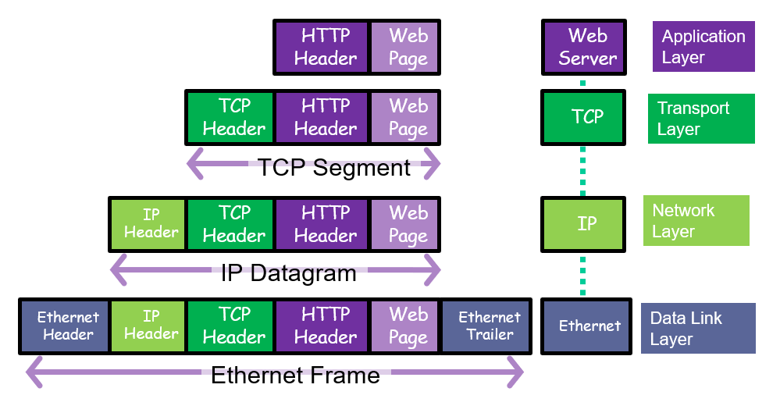
How is the mapping between a host name and its IP address done? Why do we need that mapping?
gaia.cs.umass.edu
The Network Layer adds a header containing information on IP version, source IP address, destination IP address, …
Notes:
DNS can translate domain names to both IPv4 and IPv6 addresses.

Slide 51
DNS: domain name system
Domain Name System:
a directory service that translates hostnames to IP addresses.
distributed database implemented in a hierarchy of many name servers
hosts, name servers communicate to resolve names (address/name translation)
DNS is a core Internet function, implemented as application-layer protocol
It provides service to other network applications
Unlike web and email applications, DNS is not an application with which a user directly interacts.
why not centralize DNS?

Slide 52
DNS: domain name system
Domain Name System: [RFC 1034] and [RFC 1035]
a directory service that translates hostnames to IP addresses.
distributed database implemented in a hierarchy of many name servers
application-layer protocol: hosts, name servers communicate to resolve names (address/name translation)
DNS is a core Internet function, implemented as application-layer protocol
It provides service to other network applications
Unlike web and email applications, DNS is not an application with which a user directly interacts.
why not centralize DNS?
single point of failure
traffic volume
distant centralized database
maintenance
A: doesn‘t scale!

Slide 53
DNS: domain name system
Example: a browser (i.e. an HTTP client), running on some user’s host, requests the URL: www.someschool.edu/index.html
The user machine runs the client side of the DNS application
The browser extracts the hostname, www.someschool.edu , from the URL and passes the hostname to the client side of the DNS application
The DNS client sends a query containing the hostname to a DNS server
The DNS client eventually receives a reply, which includes the IP address for the hostname
Once the browser receives the IP address from DNS, it can initiate a TCP connection to the HTTP server process located at port 80 at that IP address.

Slide 54
DNS: a distributed, hierarchical database
Root DNS Servers
…
…
Top-level domain (TLD) DNS servers
com DNS servers
org DNS servers
edu DNS servers
yahoo.com
DNS servers
pbs.org
DNS servers
poly.edu
DNS servers
umass.edu
DNS servers
authoritative DNS servers
amazon.com
DNS servers

Slide 55
Local DNS name server
does not strictly belong to hierarchy
each ISP (residential ISP, company, university) has one
also called “default name server”
when host makes DNS query, query is sent to its local DNS server
has local cache of recent name-to-address translation pairs (but may be out of date!)
acts as proxy, forwards query into hierarchy

Slide 56

DNS name resolution example
root DNS server
2
gaia.cs.umass.edu?
IP addresses for TLD servers for edu
host at cis.poly.edu wants IP address for gaia.cs.umass.edu
Queries can be iterative or recursive
3
TLD DNS server
gaia.cs.umass.edu?
4
5
IP of authoritative DNS server for umass
local DNS server
dns.poly.edu
gaia.cs.umass.edu?
gaia.cs.umass.edu?
7
6
iterative query:
contacted server replies with name of server to contact
“I don’t know this name, but ask this server”
1
8
IP address of gaia.cs.umass.edu
authoritative DNS server
dns.cs.umass.edu
requesting host
cis.poly.edu
gaia.cs.umass.edu

Slide 57
Discussion 7:
page = 1 object = small amount of HTML

Slide 58
Discussion 7 Solution
The total time to get the IP address is

Slide 59
Discussion 8
a. Non-persistent HTTP with no parallel TCP connections?

Slide 60
Discussion 8 Solution
a. Non-persistent HTTP with no parallel TCP connections?
To get IP address,
RTT₀ to get the file.
After that each small object requires 2 RTT₀ : one to establish connection, and another one to request the object then receive it.

Slide 61
Discussion 9
b. Non-persistent HTTP with the browser configured for 5 parallel connections?

Slide 62
Discussion 9
b. Non-persistent HTTP with the browser configured for 5 parallel connections?
To get IP address,
RTT₀ to get the file.
After that each 5 small objects in parallel require 2 RTT₀ : one to establish connection, and another one to request the objects then receive them.
The remaining 3 small objects in parallel require 2 RTT₀ : one to establish connection, and another one to request the objects then receive them.

Slide 63
Discussion 10
c. Persistent HTTP?
1-

Slide 64
Discussion 10 Solution
c. Persistent HTTP?
1-
Persistent means the connection is established only once for the file and all 8 objects:
RTT₀ for establishing connection.
After Connection is established, 1 RTT₀ is required to request/receive file.
With pipelining, propagation delays overlap, so all the objects will have the same request/receive time = 1 RTT₀
Note that we cannot overlap request/receive file with those of objects, because we need to completely receive the file before we remark that there are some links/objects in the file and then we can request those objects.
Therefore:

Slide 65
Discussion 11
c. Persistent HTTP?
2-

Slide 66
Discussion 11
c. Persistent HTTP?
2-
Persistent means the connection is established only once for the file and all 8 objects:
RTT₀ for establishing connection.
After Connection is established, 1 RTT₀ is required to request/receive file, then each object requires 1 RTT₀ to request/receive the object
Therefore:

Slide 67
Overlay networks

Slide 68
Question 1 D- What is an overlay network? Does it include routers? What are the edges in the overlay network?
An overlay network is a logical network implemented on top of some underlying network (such as the Internet). Each node in the overlay also exists in the underlying network; it processes and forwards packets in an application-specific way.
The overlay network, in a P2P file sharing system, consists of the nodes participating in the file sharing system and the logical links between the nodes. There is a logical link (an “edge” in graph theory terms) from node A to node B if there is a TCP connection between A and B. An overlay network does not include routers.

Slide 69
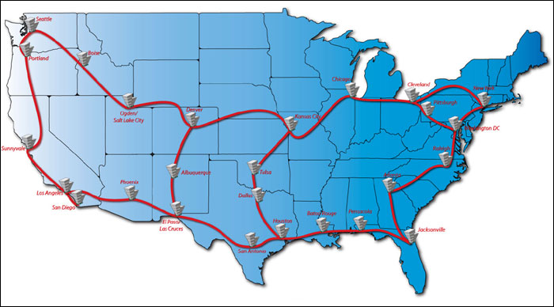
National Lambda Rail Project
IP Logical Link
Physical Circuit

Slide 70
P2P file distribution: BitTorrent
BitTorrent is a popular P2P protocol for file distribution
file divided into 256Kb chunks
peers in torrent send/receive file chunks
tracker: tracks peers
participating in torrent
torrent: group of peers exchanging chunks of a file
Alice arrives …
… obtains list
of peers from tracker
… and begins exchanging
file chunks with peers in torrent

Slide 71
Discussion 12
P25. Consider an overlay network with N active peers, with each pair of peers having an active TCP connection. Additionally, suppose that the TCP connections pass through a total of M routers.
How many nodes and edges are there in the corresponding overlay network?

Slide 72
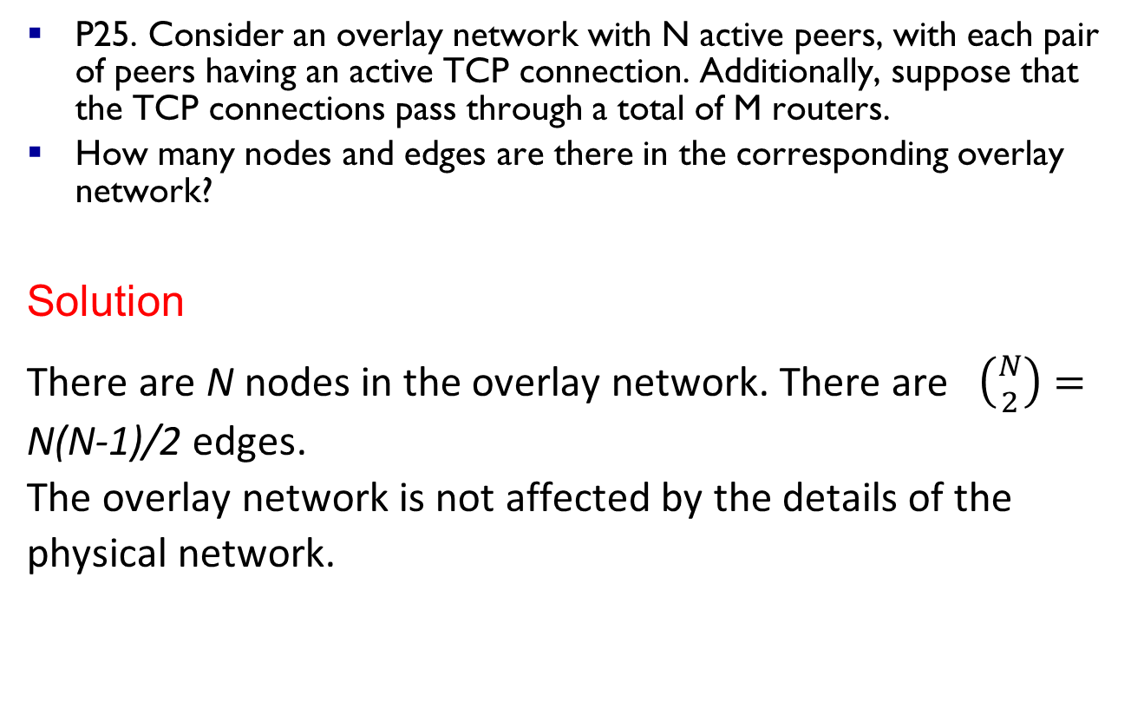
Example
P25. Consider an overlay network with N active peers, with each pair of peers having an active TCP connection. Additionally, suppose that the TCP connections pass through a total of M routers.
How many nodes and edges are there in the corresponding overlay network?
Solution
There are N nodes in the overlay network. There are $\left({N \atop 2}\right)=$ N(N-1)/2 edges.
The overlay network is not affected by the details of the physical network.

